Slide 1
Modeling the Environment and the Software
Yi Li

Slide 2
Modeling the Software: Feature Models
Calendar App for Mobile Phone
Event
Location
Sharing
Storage
Social Networks
Email
SMS
Cloud
Local
NOTE: This is a simplified feature diagram.
Environment-Aware Features
(Network Connection)

Slide 3
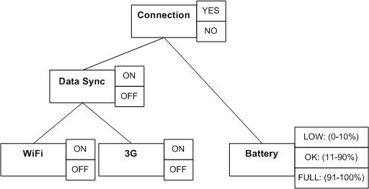
Modeling the Environment: Context Tree
Composite Context
Low-Level Context
D. Kramer, A. Kocurova, S. Oussena, T. Clark, and P. Komisarczuk. An extensible, self contained, layered approach to context acquisition. In Proceedings of the Third International Workshop on Middleware for Pervasive Mobile and Embedded Computing, M-MPAC '11, pages 6:1{6:7, New York, NY, USA, 2011. ACM.

Slide 4
Context Composition Rules
Battery, Data Sync ➔ Connection
…
LOW, ON ➔ NO
…
WiFi , 3G ➔ Data Sync
ON, ON ➔ ON
ON, OFF ➔ ON
OFF, ON ➔ ON
OFF, OFF ➔ OFF

Slide 5
Bind Environment and Feature
Bind a feature to a context value

Slide 6
Implement Adaption
Feature selection/removal at run time

